Slide 1
Azure Automation
Hands-On Challenge

Slide 2
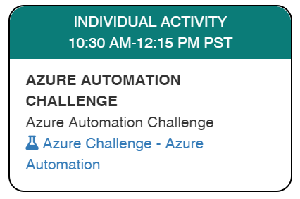
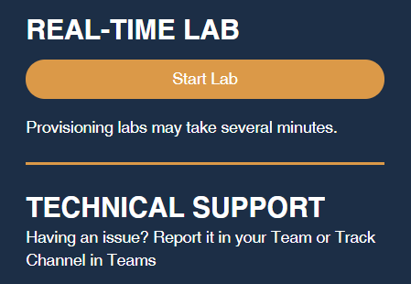
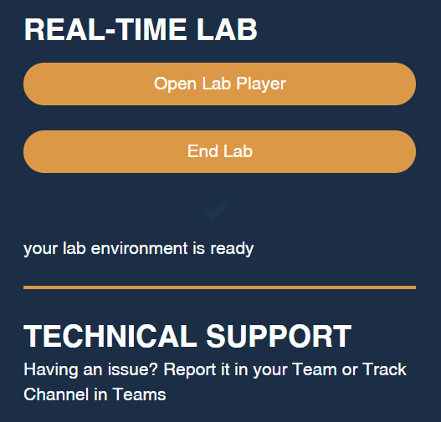
Launch the Lab Environment
Important! Allow at least 1 hour for your lab to start

Slide 3
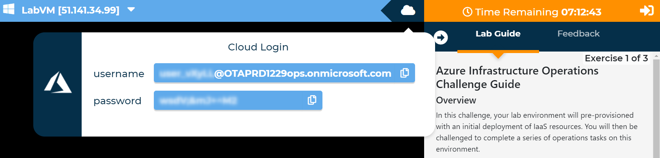
Access Your Lab

Slide 4
Challenges
Challenge 1: Implement Custom Health Probes
In This Challenge, You Will Use Azure Automation To Both Update An Azure Resource Configuration And Implement A Change Within An Azure VM.
Challenge 2: Re-Size Load-Balanced VMs
In This Challenge, You Will Roll Out A Change To Your Web Tier VMs, While Preserving Application Availability.
Challenge 3: Parallel Tasks Using PowerShell Workflow
In This Challenge, You Will Use PowerShell Workflow To Parallelize The Deployment Of Azure Resource Manager Templates.
Note Automatic validation of your solution has been disabled to speed up the lab for you
Notes:
In this challenge, your lab environment will pre-provisioned with an initial deployment of IaaS resources. You will then be challenged to complete a series of operations tasks on this environment.
These include configuring the 'VM Insights' solution and enabling automatic enrollment of virtual machines, using Azure Resource Graph to explore the deployed resources, and building an Azure Monitor Workbook.
The lab will not validate that each challenge has been completed correctly, so pay close attention to the requirements in each challenge.

Slide 5
Need help?
Use the Teams chat channel
Solutions will be given in tomorrow morning's kick-off session

